Slide 1




My Algebra Interactive Notebook
$$3ab$$
$$2x+3y$$
$$\frac{5xy}{6}$$
Name :
Class :
Term 2 Semester 1
$$y=2x+1$$

Slide 2
Contents
Glossary
Page
Date
Description
2
3

Slide 3
Tasks
24
7
30
Essential Question
Questions
Notes
Summary
4
7

Slide 4
24
7
30
Date
Factorising Expressions
EQ – How do I use the HCF to factorise expressions?

Slide 5
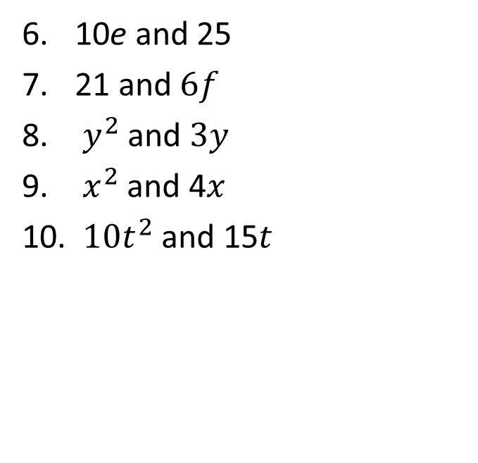
Task
Find the HCF of the following
2 and 4
10 and 15
2a and 6
10a and 15b
2c and 10
10e and 25
21 and $6f$
$y^{2}$ and $3y$
$x^{2}$and 4$x$
$10t^{2}$and 15$t$

Slide 6
24
7
30
Date
Factorising Expressions
EQ – How do I use the HCF to factorise expressions?
What is the HCF?
HCF – Highest Common factor

Slide 7

24
7
30
Date
Factorising Expressions
EQ – How do I use the HCF to factorise expressions?
What is the HCF?
HCF – Highest Common factor
How do I factorise?
Factorise $2p+10$

Slide 8
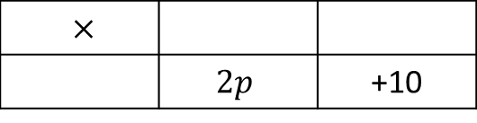
24
7
30
Date
Factorising Expressions
EQ – How do I use the HCF to factorise expressions?
What is the HCF?
HCF – Highest Common factor
How do I factorise?
Factorise $2p+10$
$×$
 | $$2p$$ | +10
Find the HCF of both terms

Slide 9
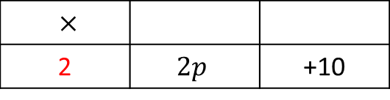
24
7
30
Date
Factorising Expressions
EQ – How do I use the HCF to factorise expressions?
What is the HCF?
HCF – Highest Common factor
How do I factorise?
Factorise $2p+10$
$×$
2 | $$2p$$ | +10
Find the HCF of both terms

Slide 10
24
7
30
Date
Factorising Expressions
EQ – How do I use the HCF to factorise expressions?
What is the HCF?
HCF – Highest Common factor
How do I factorise?
Factorise $2p+10$
Divide terms by HCF
$×$
2 | $$2p$$ | +10
Find the HCF of both terms

Slide 11
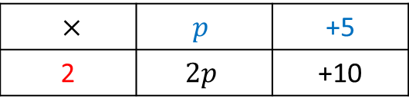
24
7
30
Date
Factorising Expressions
EQ – How do I use the HCF to factorise expressions?
What is the HCF?
HCF – Highest Common factor
How do I factorise?
Factorise $2p+10$
Divide terms by HCF
$×$ | $$p$$ | +5
2 | $$2p$$ | +10
Find the HCF of both terms
Write the expression using brackets

Slide 12

24
7
30
Date
Factorising Expressions
EQ – How do I use the HCF to factorise expressions?
What is the HCF?
HCF – Highest Common factor
How do I factorise?
Factorise $2p+10$
Divide terms by HCF
$×$ | $$p$$ | +5
2 | $$2p$$ | +10
Find the HCF of both terms
Write the expression using brackets
$$2(p+5)$$

Slide 13

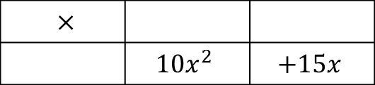
24
7
30
Date
Factorising Expressions
EQ – How do I use the HCF to factorise expressions?
What is the HCF?
HCF – Highest Common factor
How do I factorise?
Factorise $2p+10$
Divide terms by HCF
$×$ | $$p$$ | +5
2 | $$2p$$ | +10
Find the HCF of both terms
Write the expression using brackets
$$2(p+5)$$
Factorise $10x^{2}+15x$
$×$
 | $$10x^{2}$$ | $$+15x$$

Slide 14
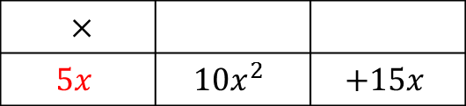
24
7
30
Date
Factorising Expressions
EQ – How do I use the HCF to factorise expressions?
What is the HCF?
HCF – Highest Common factor
How do I factorise?
Factorise $2p+10$
Divide terms by HCF
$×$ | $$p$$ | +5
2 | $$2p$$ | +10
Find the HCF of both terms
Write the expression using brackets
$$2(p+5)$$
Factorise $10x^{2}+15x$
$×$
$$5x$$ | $$10x^{2}$$ | $$+15x$$

Slide 15
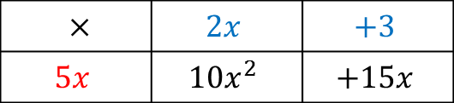
24
7
30
Date
Factorising Expressions
EQ – How do I use the HCF to factorise expressions?
What is the HCF?
HCF – Highest Common factor
How do I factorise?
Factorise $2p+10$
Divide terms by HCF
$×$ | $$p$$ | +5
2 | $$2p$$ | +10
Find the HCF of both terms
Write the expression using brackets
$$2(p+5)$$
Factorise $10x^{2}+15x$
$×$ | $$2x$$ | $$+3$$
$$5x$$ | $$10x^{2}$$ | $$+15x$$

Slide 16

24
7
30
Date
Factorising Expressions
EQ – How do I use the HCF to factorise expressions?
What is the HCF?
HCF – Highest Common factor
How do I factorise?
Factorise $2p+10$
Divide terms by HCF
$×$ | $$p$$ | +5
2 | $$2p$$ | +10
Find the HCF of both terms
Write the expression using brackets
$$2(p+5)$$
Factorise $10x^{2}+15x$
$×$ | $$2x$$ | $$+3$$
$$5x$$ | $$10x^{2}$$ | $$+15x$$
$$10x^{2}+15x=5x(2x+3)$$

Slide 17
Notes Review
24, 7 ,30
Date
Title
Essential question
Notes complete
Notes complete with colour and diagrams
Questions completed
Contents page filled in
Formula page filled in

Slide 18
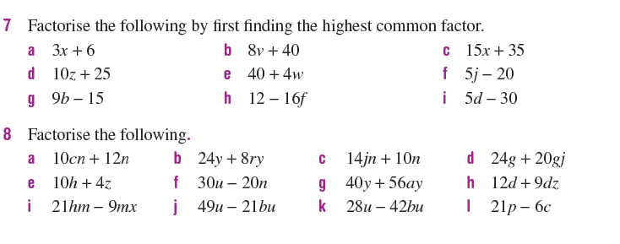
Textbook page 300

Slide 19
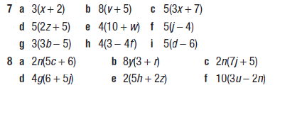


Slide 20
Homework
Review your notes and write a summary answering the essential question.

